Slide 1
Anatomy of a Learning Algorithm
Scott O’Hara
Metrowest Developers Machine Learning Group
01/13/2021

Slide 2
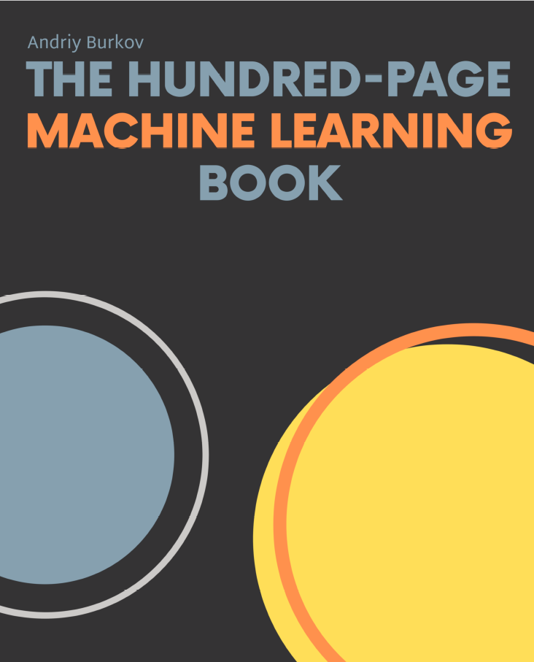
Concise definitions and well-thought-out examples.
~140 pages.
Covers mostly supervised learning.
Provides pointers to things it doesn’t cover.
Generally, a good summary of things you should know about ML.

Slide 3
Online Resources
Website: http://themlbook.com/
Wiki: http://themlbook.com/wiki/doku.php
Git: https://github.com/aburkov/theMLbook

Slide 4
Author: Dr. Pedro Domingos
Communications of the ACM – October 2012.
Written in 2012, Domingos attempted to convey the “black art” of machine learning in an article covering 12 topics i.e., the “folk knowledge” and rules of thumbs that are know by ML practitioners but that are not taught in universities.

Slide 5
The 100 Page ML Book: Contents
Chapter 1: Introduction
Chapter 2: Notation and Definitions
Chapter 3: Fundamental Algorithms
Chapter 4: Anatomy of a Learning Algorithm
Chapter 5: Basic Practice
Chapter 6: Neural Networks and Deep Learning
Chapter 7: Problems and Solutions
Chapter 8: Advanced Practice
Chapter 9: Unsupervised Learning
Chapter 10: Other Forms of Learning
Chapter 11: Conclusion
Credit: The Hundred-Page Machine Learning Book, A. Burkov, 2019

Slide 6
Learning = Representation + Evaluation + Optimization
Supervised learning algorithm can be reduced to three components:
Representation
Evaluation
Optimization
Credit: ”A Few Useful Things to Know About Machine Learning”, P. Domingos, C. of the ACM, Oct 2012, Vol. 55, No. 10

Slide 7
Learning = Representation + Evaluation + Optimization
A classifier must be represented in some formal language that the computer can handle.
Choosing a representation is tantamount to choosing the set of classifiers that can be learned. This is called the hypothesis space.
If a classifier is not in the hypothesis space, it cannot be learned.
Credit: ”A Few Useful Things to Know About Machine Learning”, P. Domingos, C. of the ACM, Oct 2012, Vol. 55, No. 10

Slide 8
Learning = Representation + Evaluation + Optimization
An evaluation function is needed to distinguish good classifiers from bad ones.
Sometimes called the objective function or the scoring function.
Credit: ”A Few Useful Things to Know About Machine Learning”, P. Domingos, C. of the ACM, Oct 2012, Vol. 55, No. 10

Slide 9
1. Learning = Representation + Evaluation + Optimization
A method is needed to search the set of classifiers for the highest-scoring one.
The choice of optimization technique determines the efficiency of the learner.
The optimization technique uses the evaluation function.
Credit: ”A Few Useful Things to Know About Machine Learning”, P. Domingos, C. of the ACM, Oct 2012, Vol. 55, No. 10

Slide 10
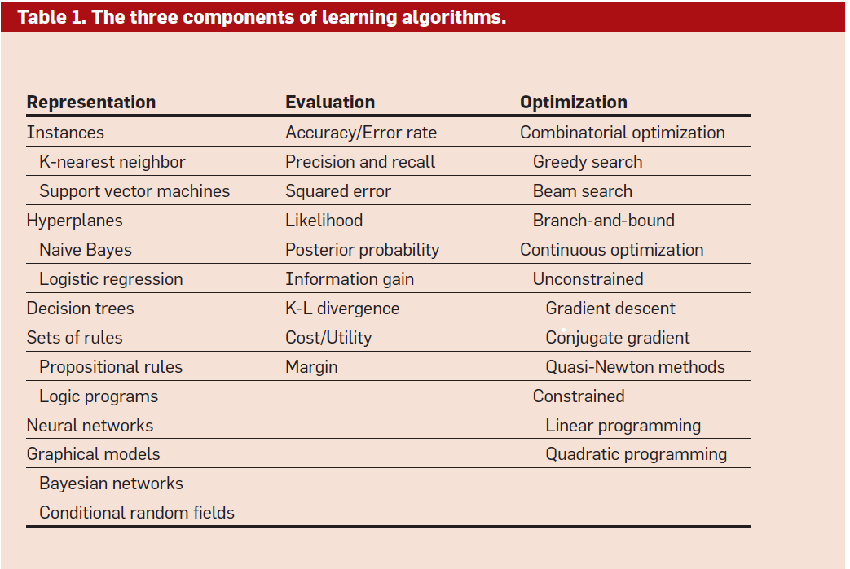
Learning = Representation + Evaluation + Optimization
Credit: ”A Few Useful Things to Know About Machine Learning”, P. Domingos, C. of the ACM, Oct 2012, Vol. 55, No. 10

Slide 11
Linear Regression Example
Representation: line
Evaluation: minimize mean squared error
Optimization: gradient descent
Credit: The Hundred-Page Machine Learning Book, A. Burkov, 2019

Slide 12
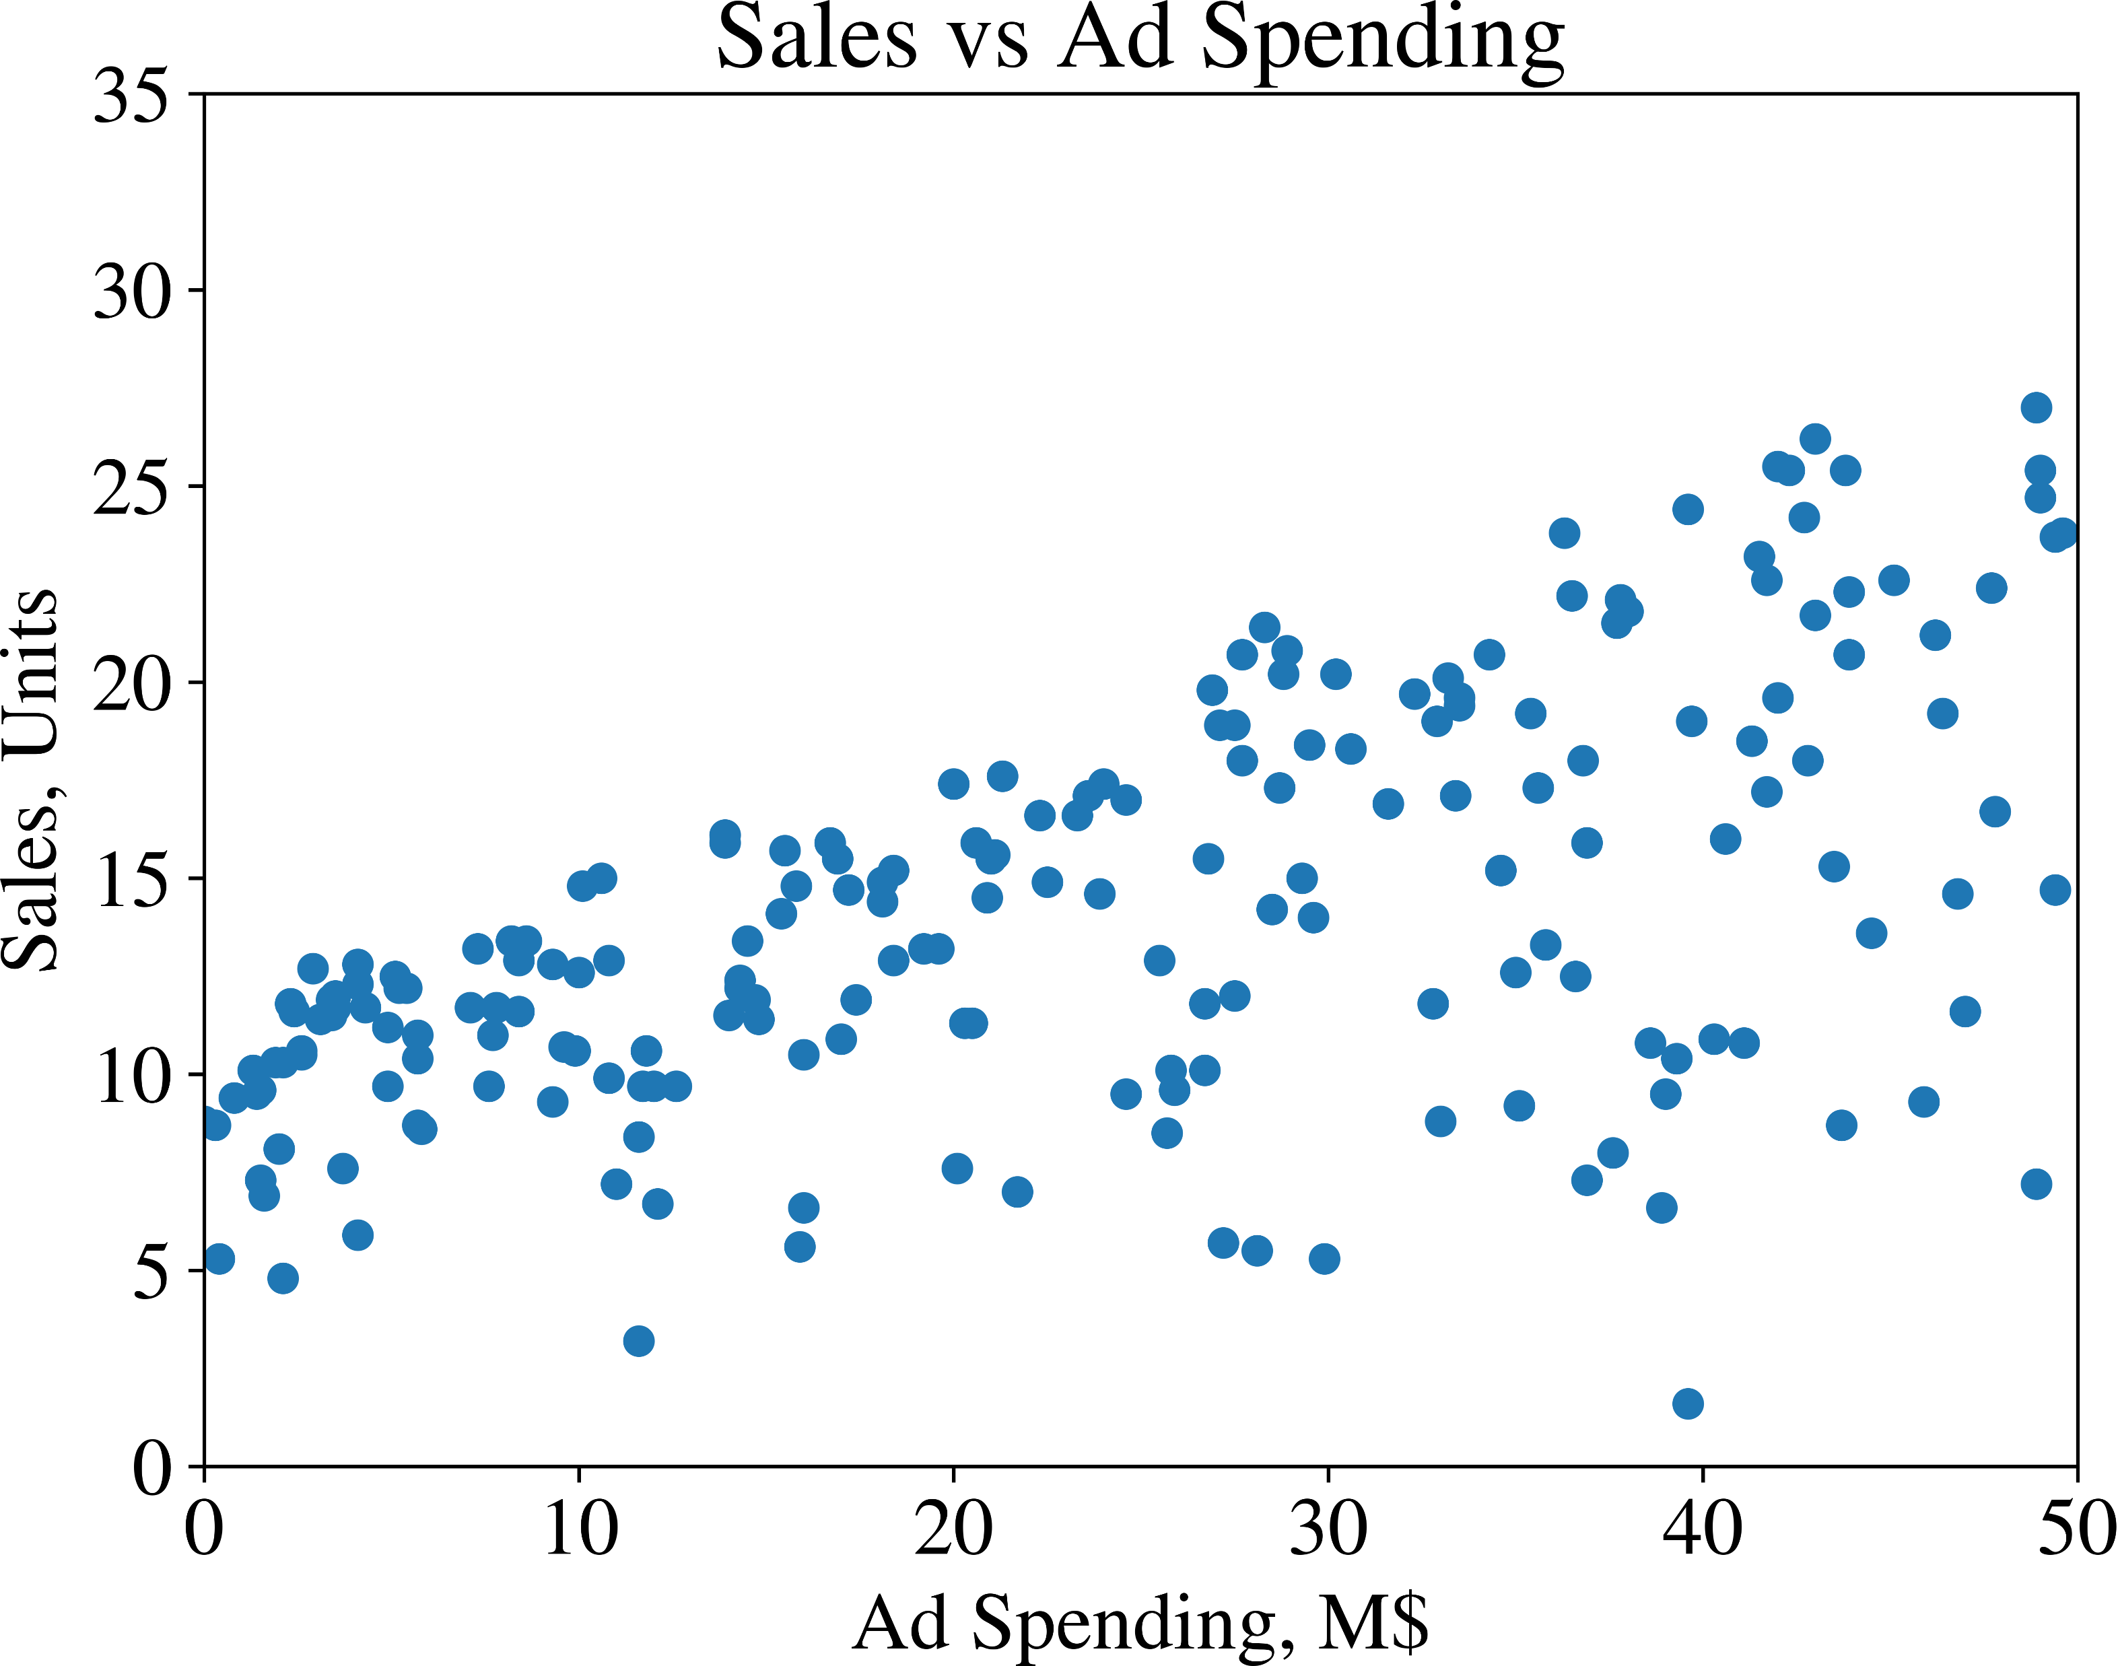
Example: Sales vs Ad Spending
Credit: The Hundred-Page Machine Learning Book, A. Burkov, 2019

Slide 13
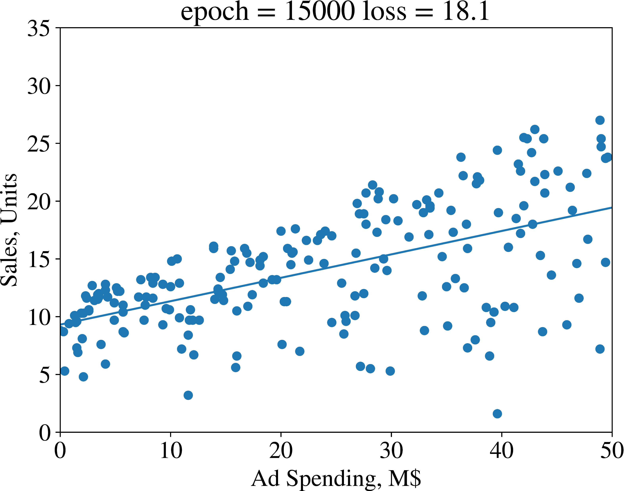
Fit Regression Line to data to predict Unit sales given Ad Spending
Credit: The Hundred-Page Machine Learning Book, A. Burkov, 2019

Slide 14
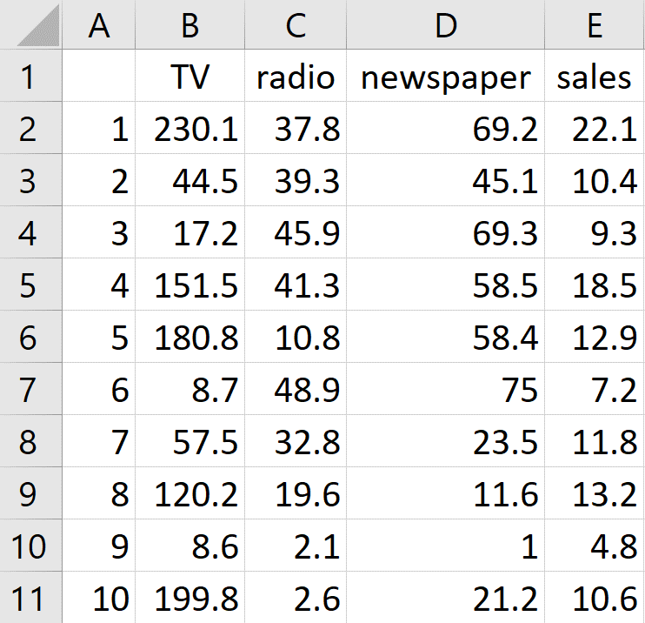




advertising.csv
Credit: The Hundred-Page Machine Learning Book, A. Burkov, 2019

Slide 15
Representation: The linear Regression Model
Model Parameters
Unit Sales
Radio Ad Spending

Slide 16
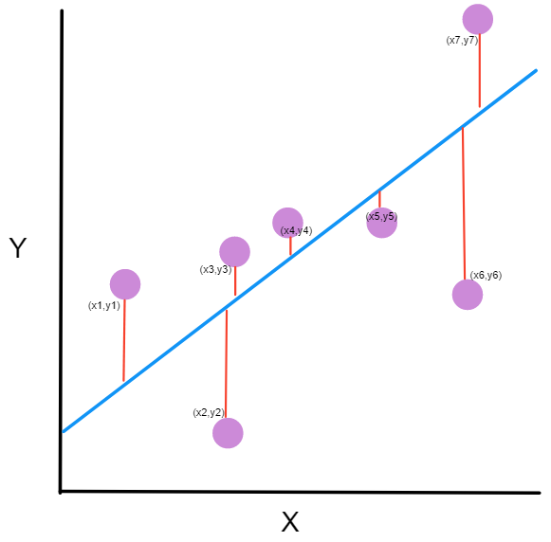
Minimize mean-Squared Error
EVALUATION:
Credit: image from https://www.freecodecamp.org/news/machine-learning-mean-squared-error-regression-line-c7dde9a26b93/. Retrieved 01/13/2021.

Slide 17
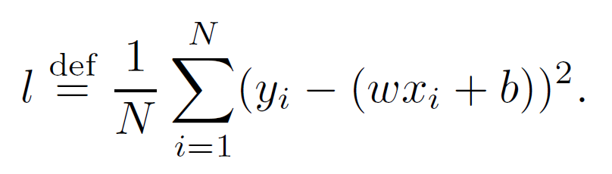
EVALUATION: Minimize mean-Squared Error
Size of Training Set
Loss
Actual
Value
Model
Prediction

Slide 18
Optimization: Gradient Descent

Slide 19
Optimization: Gradient Descent
Credit: The Hundred-Page Machine Learning Book, A. Burkov, 2019

Slide 20
Gradient Descent: EPOCHS, Learning Rate
Credit: The Hundred-Page Machine Learning Book, A. Burkov, 2019

Slide 21
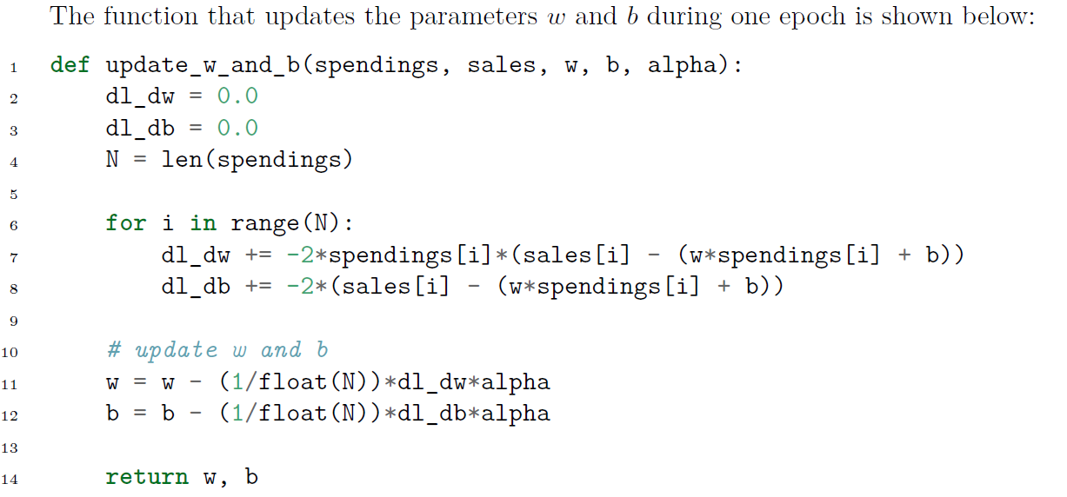
Gradient Descent: update_w_and_B
Credit: The Hundred-Page Machine Learning Book, A. Burkov, 2019

Slide 22
Main Loop: Loop over multiple Epochs
Credit: The Hundred-Page Machine Learning Book, A. Burkov, 2019

Slide 23
Gradient Descent: AVG_LOSS
Credit: The Hundred-Page Machine Learning Book, A. Burkov, 2019

Slide 24
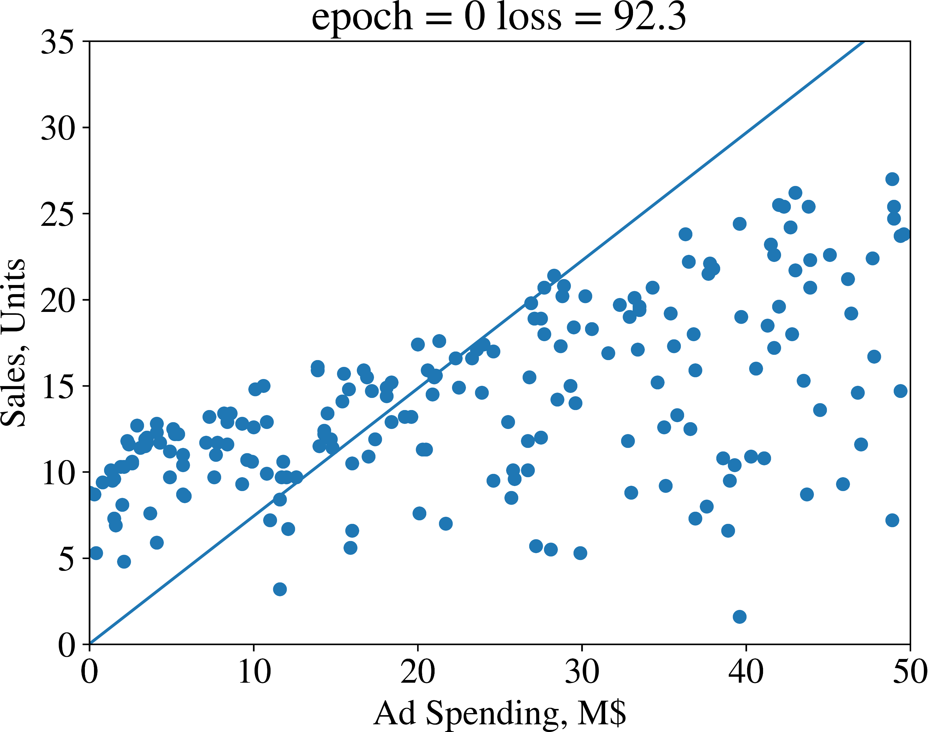
Credit: The Hundred-Page Machine Learning Book, A. Burkov, 2019

Slide 25
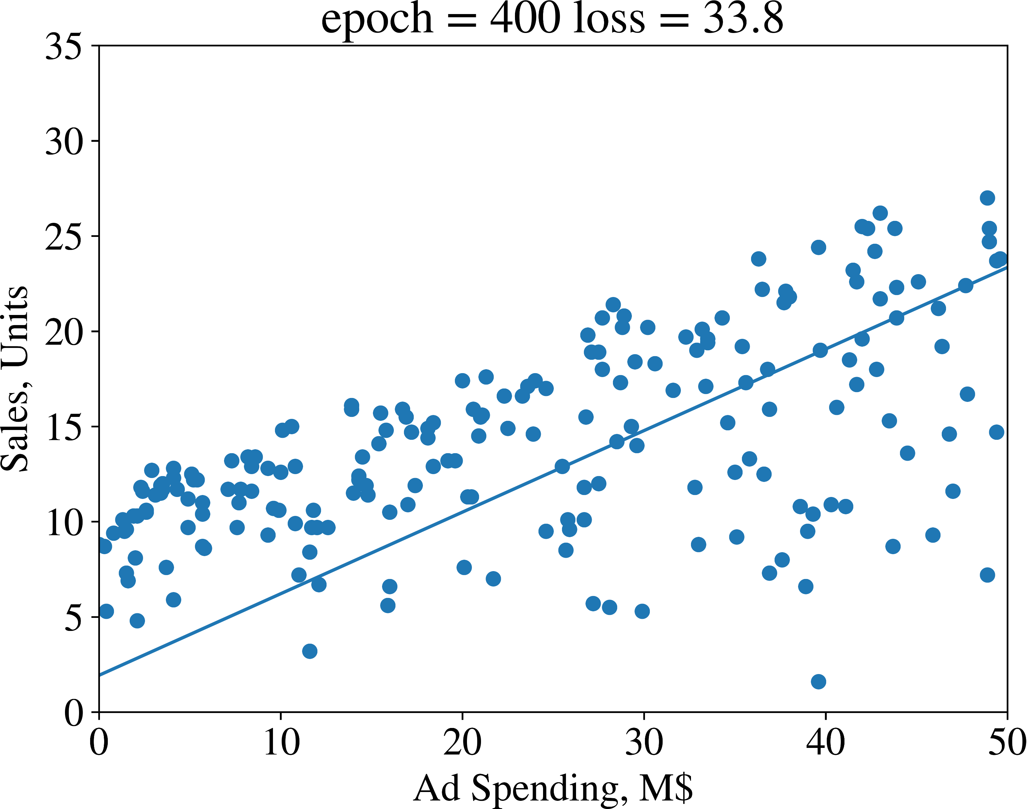
Credit: The Hundred-Page Machine Learning Book, A. Burkov, 2019

Slide 26
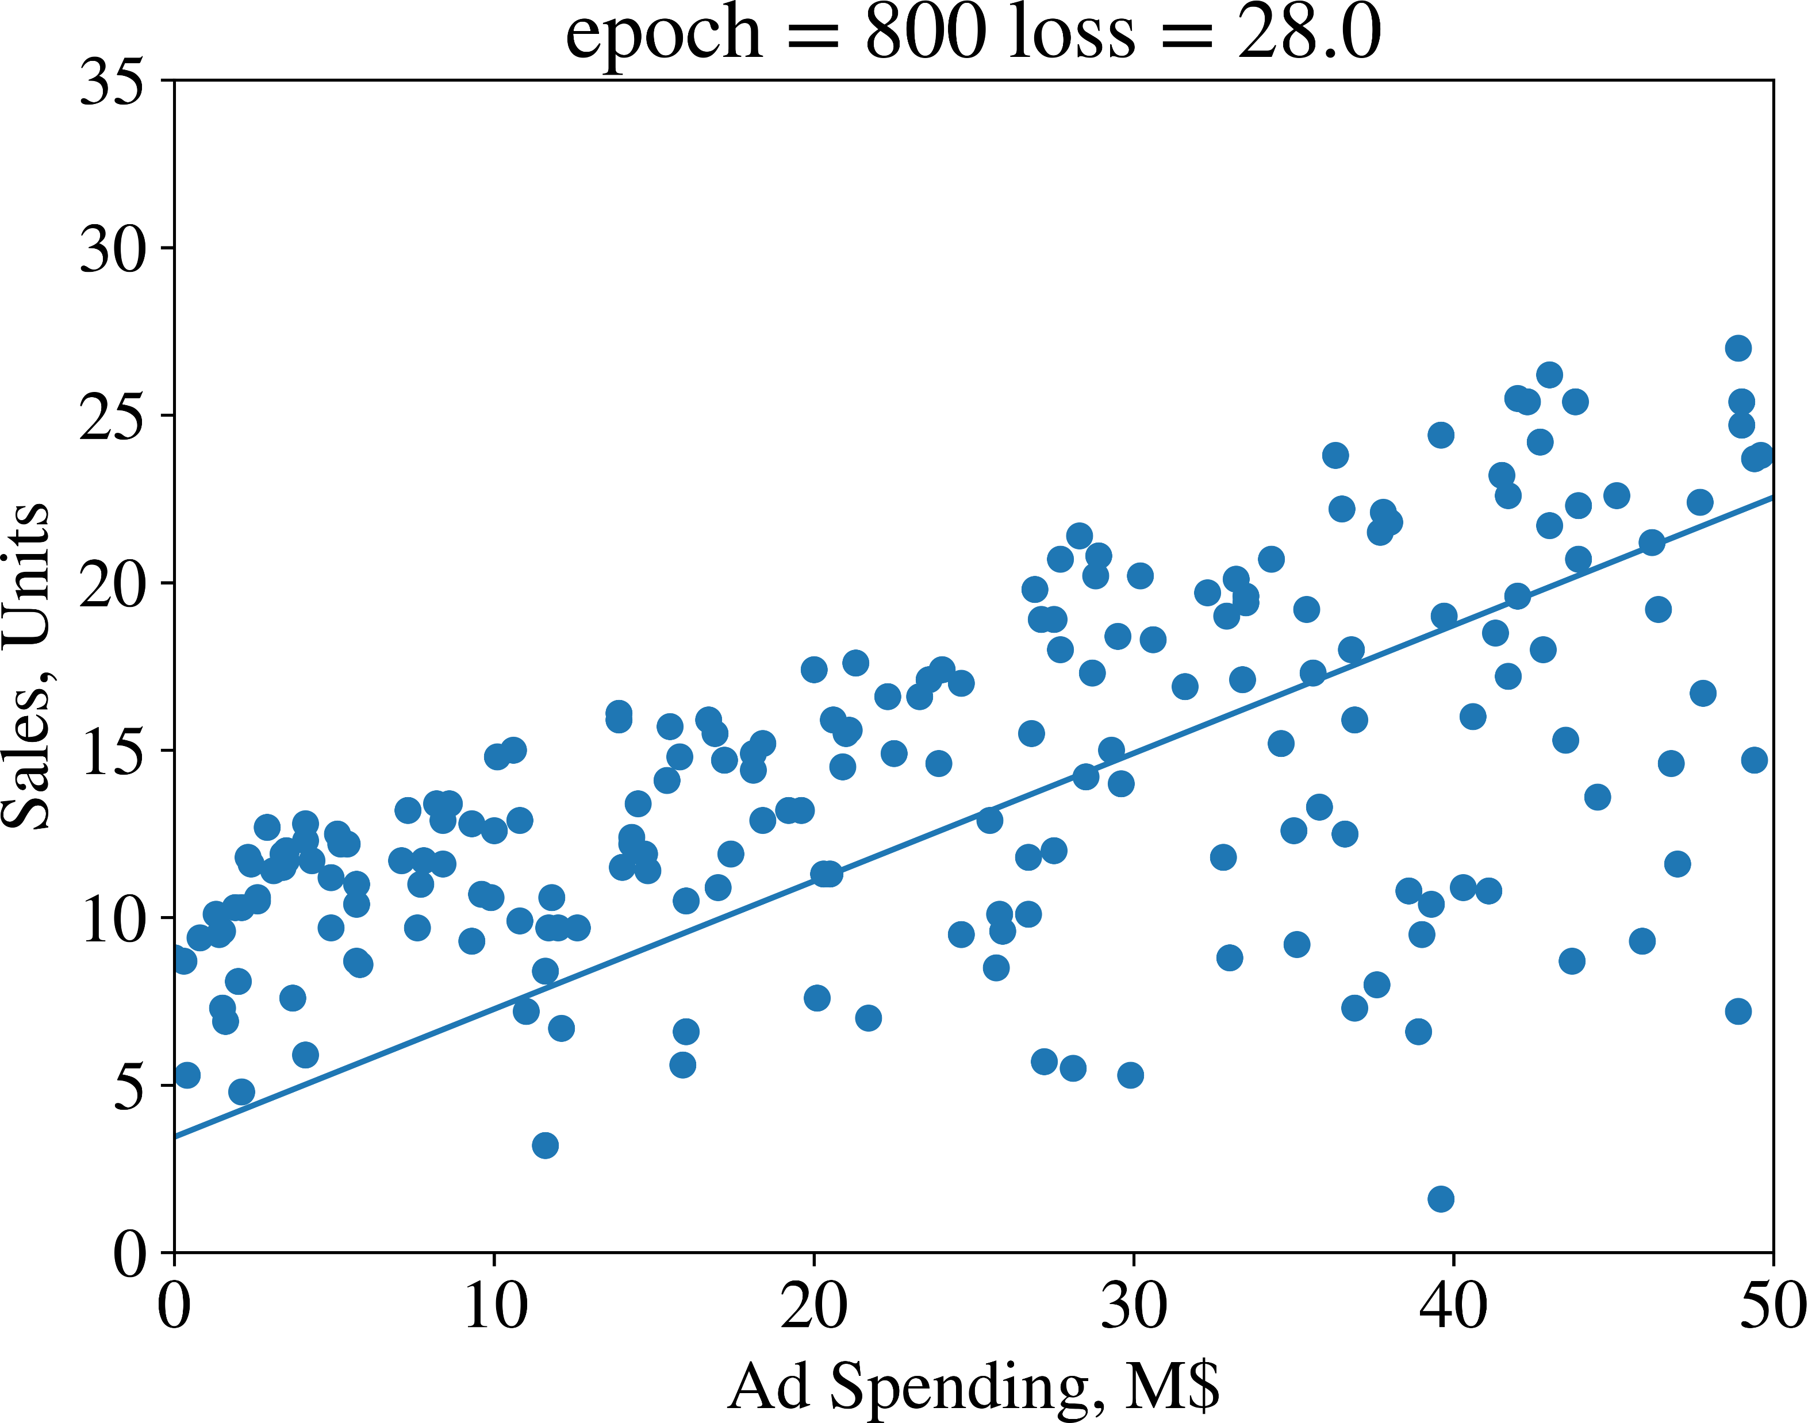
Credit: The Hundred-Page Machine Learning Book, A. Burkov, 2019

Slide 27

Credit: The Hundred-Page Machine Learning Book, A. Burkov, 2019

Slide 28

Credit: The Hundred-Page Machine Learning Book, A. Burkov, 2019

Slide 29

Credit: The Hundred-Page Machine Learning Book, A. Burkov, 2019

Slide 30

Credit: The Hundred-Page Machine Learning Book, A. Burkov, 2019

Slide 31

Credit: The Hundred-Page Machine Learning Book, A. Burkov, 2019

Slide 32

Credit: The Hundred-Page Machine Learning Book, A. Burkov, 2019

Slide 33

Credit: The Hundred-Page Machine Learning Book, A. Burkov, 2019

Slide 34

Credit: The Hundred-Page Machine Learning Book, A. Burkov, 2019

Slide 35

Credit: The Hundred-Page Machine Learning Book, A. Burkov, 2019

Slide 36

Credit: The Hundred-Page Machine Learning Book, A. Burkov, 2019

Slide 37
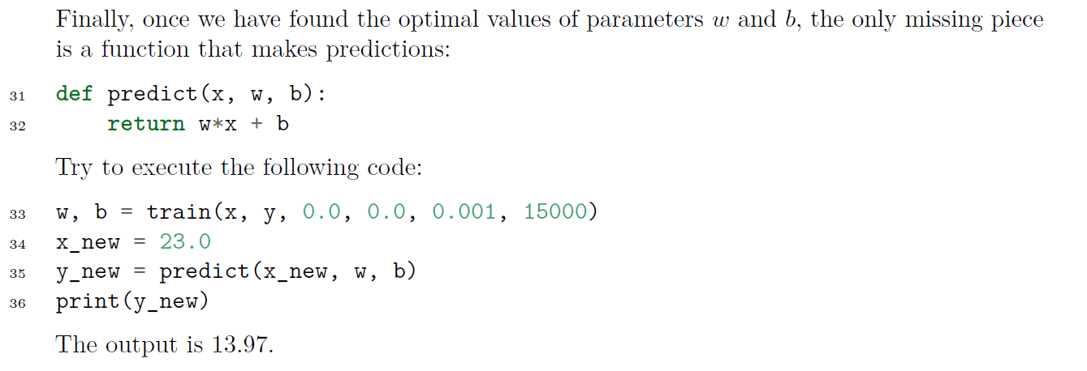
Gradient Descent: PREDICT
Credit: The Hundred-Page Machine Learning Book, A. Burkov, 2019

Slide 38
Learning = Representation + Evaluation + Optimization
Representation:
Provides the model structure.
The parameters define the search space of possible models.
Evaluation:
Defines the criteria for successful learning.
Gives a method to compare one model to another and decide which one is preferred.
Optimization:
Specifies an algorithmic process to find an optimal model.

Slide 39
Learning = Representation + Evaluation + Optimization
Representation: line
Evaluation: minimize mean squared error
Optimization: gradient descent
Credit: The Hundred-Page Machine Learning Book, A. Burkov, 2019

Slide 40
Learning = Representation + Evaluation + Optimization
Credit: ”A Few Useful Things to Know About Machine Learning”, P. Domingos, C. of the ACM, Oct 2012, Vol. 55, No. 10

Slide 41
Anatomy of a Learning Algorithm
Scott O’Hara
Metrowest Developers Machine Learning Group
12/16/2020

